Slide 1
UX Design: For developers or nah?
Gabriel “G” Nhinda
Twitter: @JustShingapi
www.unam.na (@unam_na)

Slide 2
Agenda/To Do/Talking Points/ …
Why now
How did I get into this
Now we start
Okay, this is the middle
Almost the end
Almost almost the end
Other stuff (remove before presentation)

Slide 3
Why now
Adoption of mobile
Differentiation of services
Personalisation of software
Evolution of design principles
Options
Nobody likes wasting time on simple tasks, they are busy trying to pretend to be busy! (unless its procrastination via YouTube and cute ninja turtle baby dinosaurs!)
Customer Experience

Slide 4
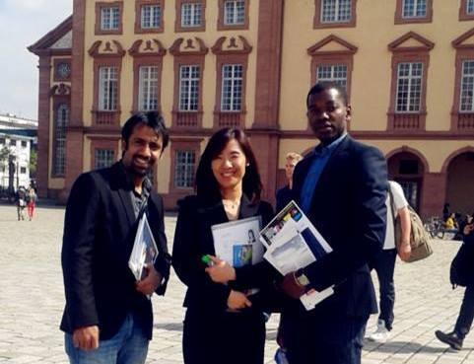
How did I get into this (Graduate Student livin’ it up)

Slide 5
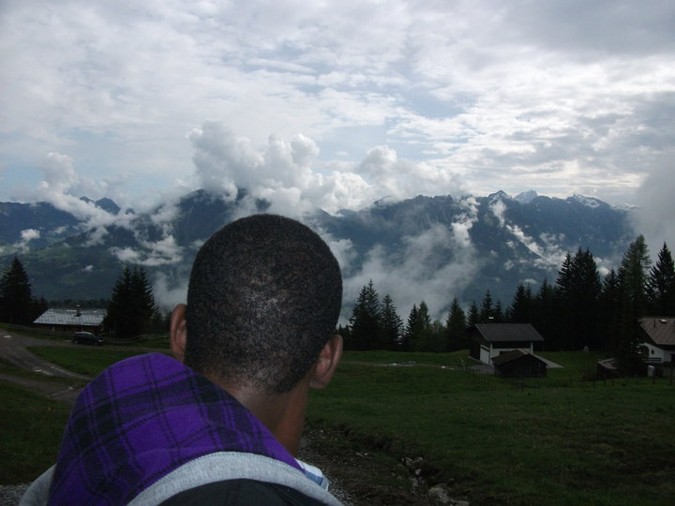
How did I get into this (Graduate Student livin’ it up)

Slide 6
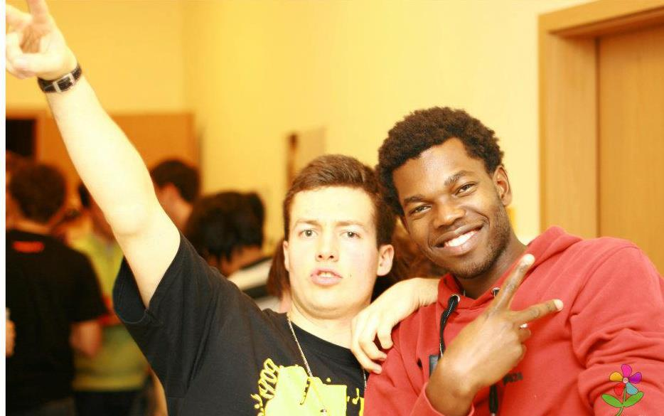
How did I get into this (Graduate Student livin’ it up)

Slide 7
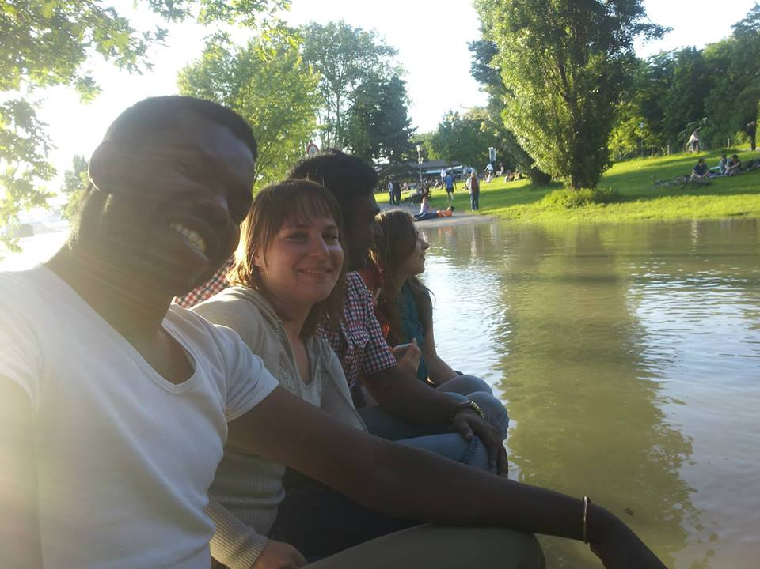
How did I get into this (Graduate Student livin’ it up)

Slide 8
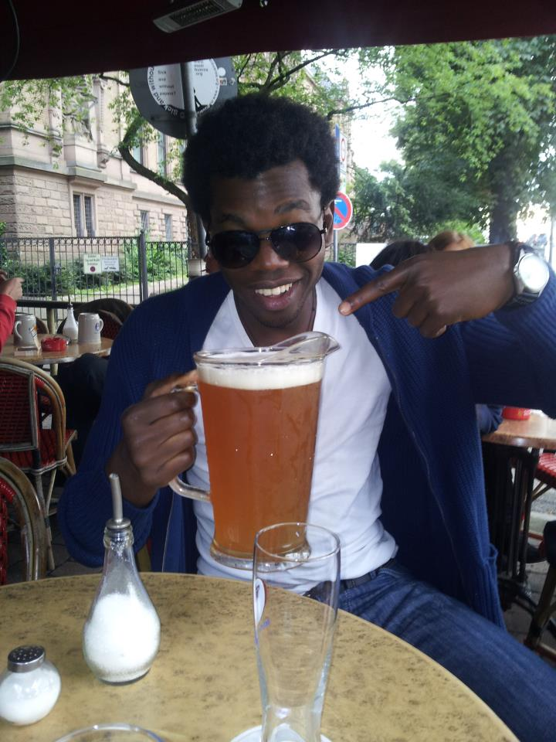
How did I get into this (Graduate Student livin’ it up)

Slide 9
How did I get into this
Cutting edge hardcore Front-end developer (XAML + C#) for ARM MS Metro Styled Windows 8 (after 4 months it sucked!)
Check-list background: Technical Server room and Networking (used this approach for the UI=UX): What design principles?
Final presentation resulted in a range or emotions: anger, shock, disbelieve, intrigue
So, I got a job in a UX department of the largest middleware vendor in Germany

Slide 10
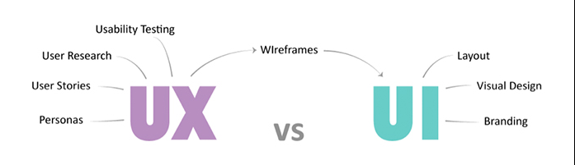
Now we start
UX is the technical study of how users interact with your product/software

Slide 11
Now we start Cont…
The three commandments I live by:
1. You are not your users
2. Know thy Users
3. Not all users are the same

Slide 12
1. You are not your users
You know your product inside out, well since you thought of it!
You might end up wasting a lot of person-hours only to find that’s not what your client wanted.
“Knowing how people will use something is essential” – Donald Norman

Slide 13
2. Know thy Users
“UX Without Users is NOT UX”
- Nielsen Norman Group
USER RESEARCH
Notes:
Helps us build empathy
helps us identify and fill gaps in knowledge
Helps us identify what functionality is most critical
Helps us improve usability of interactive systems
Don’t make assumptions about your user
Go out and meet them
Gather data
Perform user testing
Understand how they differ
What their goals are
What their needs are
How they think and feel

Slide 14
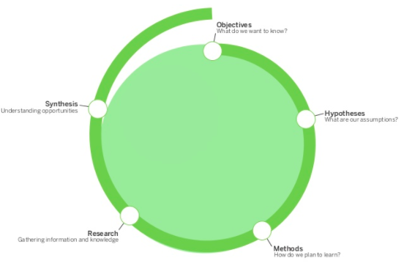
2. Know thy Users
Notes:
Helps us build empathy
helps us identify and fill gaps in knowledge
Don’t make assumptions about your user
Go out and meet them
Gather data
Perform user testing
Understand how they differ
What their goals are
What their needs are
How they think and feel

Slide 15
3. Not all users are the same
Some know what they want and can tell you
Some know what they want and want you to tell them
Some know what they want but can’t tell you
Some want everything
Some don’t know what they want but want something
Some don’t even want
Some don’t want they need
Some don’t really want but have #FOMO

Slide 16
Okay, this is the middle
Ohh I still don’t want to make things look “pretty”!
No Need, get a Graphics Designer and a Front-end Developer!
UX doesn’t deal with beautification – Directly!

Slide 17
Okay, this is the middle
Just ask some basic questions before, during and after you are done with your project – but… like, Listen and iterate on design, you won’t die!

Slide 18
Almost the end
Developers and UX’ers share a common goal
Developer: “Is the process an efficient use of resources”
UX: “Is the process efficient for the user?”

Slide 19
Almost almost the end
Dev: Technical Scope
Project
UX: User Flow
User flow should define
Technical Scope

Slide 20
References (If you can read this and you are interested in learning more about UX read the list below ☺)
Designing the Obvious – Robert Hoekman, Jr.
Sketching User Experiences – Bill Buxton
Don’t Make me think – Steve Krug
Please also read on Norman Nielsen’s work and heuristics evaluation and a bunch of stuff from the uxmag.com

Slide 21
Thank you
Gabriel “G” Nhinda
Twitter: @JustShingapi Twitter: @pyconNa na.pycon.org www.unam.na

